Slide 1
Graphs
EQ: How do I interpret information presented in tables?

Slide 2
Learning Outcomes
Dot Points
1.4.2 interpret information presented in two-way tables
Contexts
Understand the data that is presented in tables in a range of situations

Slide 3
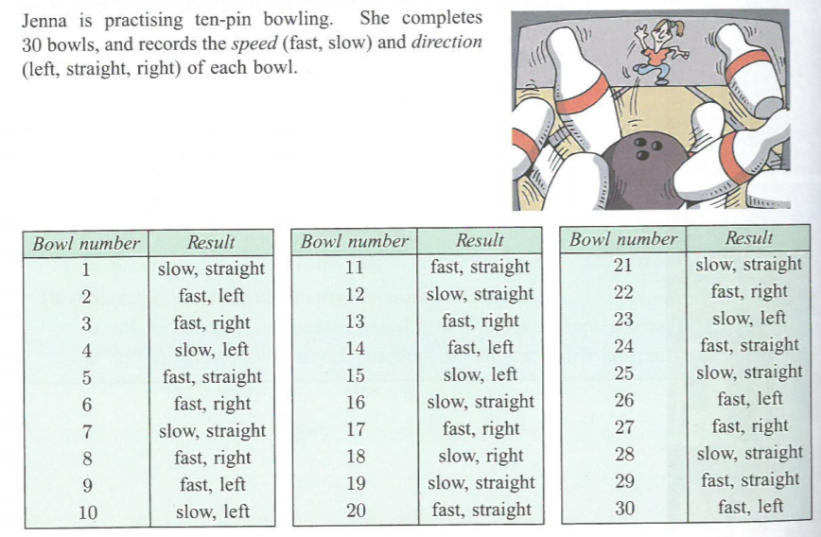
Opening Problem- Class Discussion:
“Why is it difficult to read and analyse the data in this format?”

Slide 4
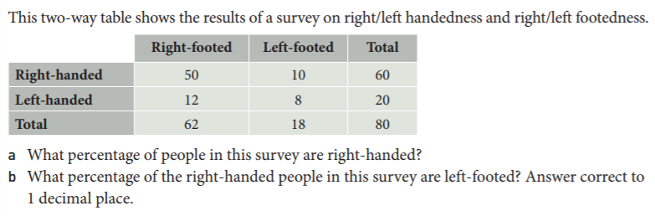
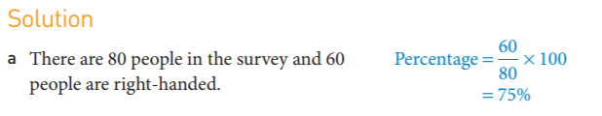

24
7
30
Topic: Graphs
Date
EQ: How do I interpret information presented in tables?
Two-way tables show two characteristics of any data set
Example:

Slide 5
Complete Interpreting tables worksheet

